Slide 1
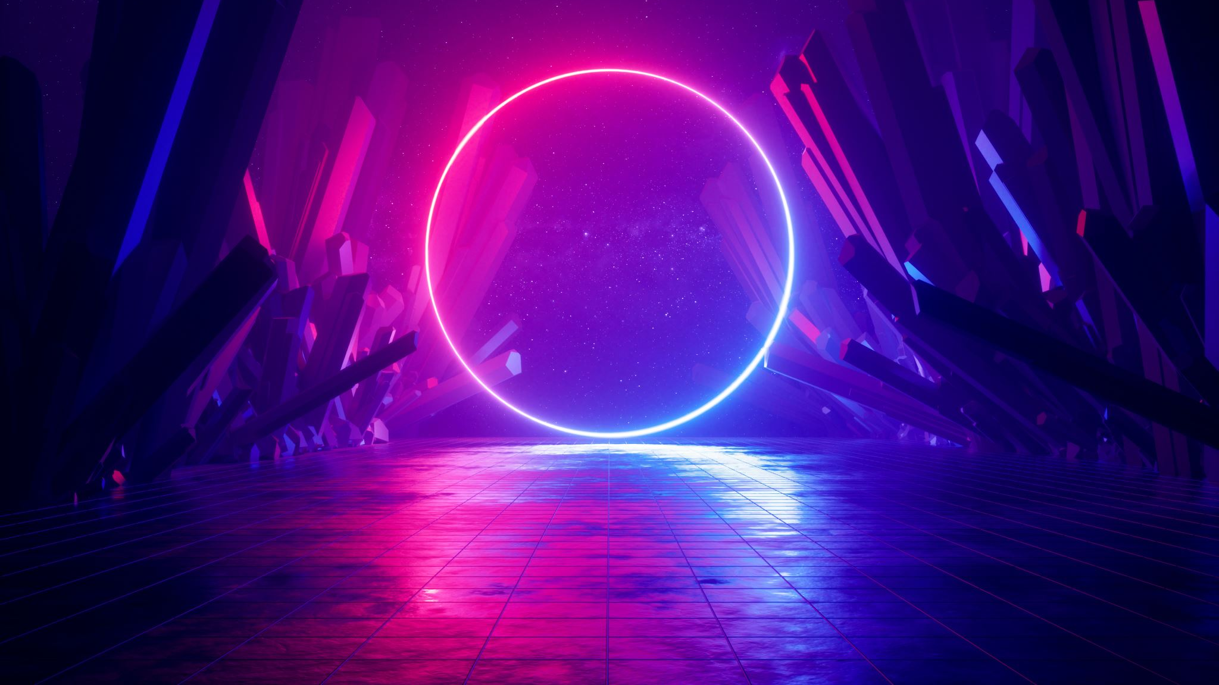
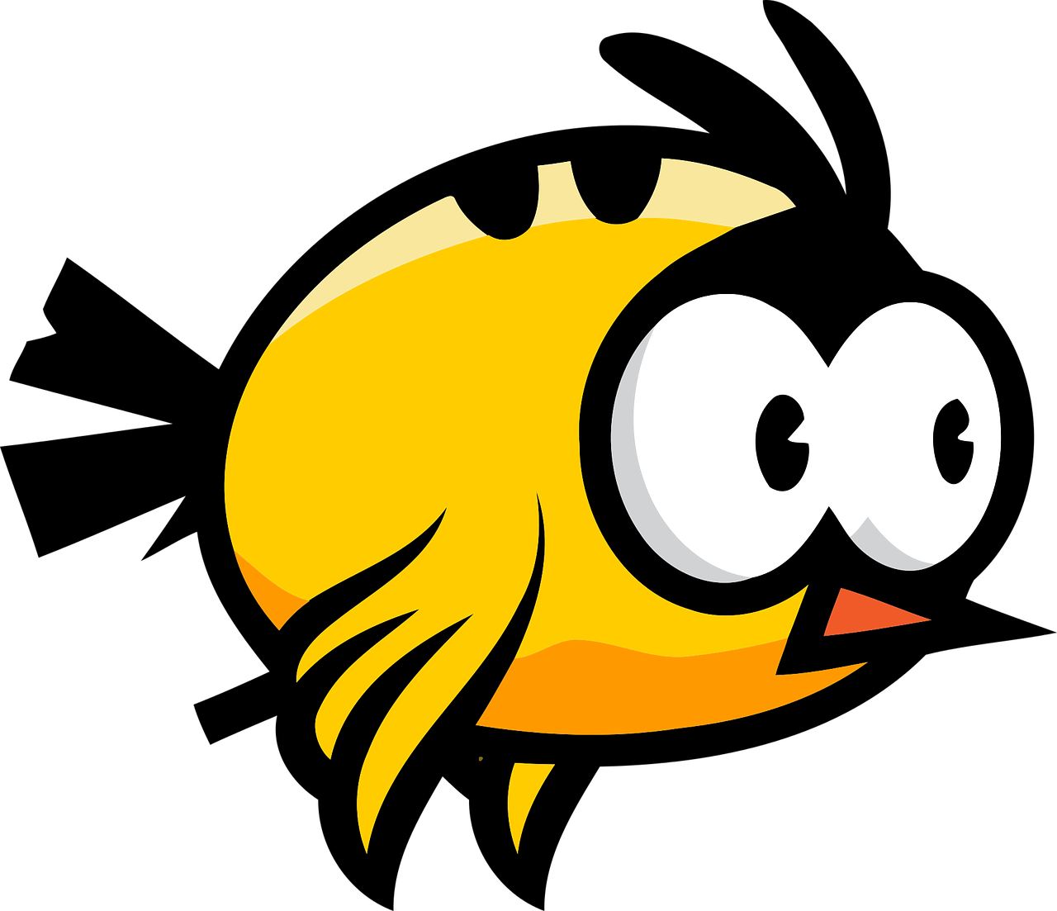
FLAPPY BIRD
Game using java script

Slide 2

INTRODUCTION
About the Game:
Flappy Bird is a timeless classic known for its simple yet addictive gameplay.
In my version, you control a bird with a single click using space bar or tap arrow up key or using ‘W’ key to navigate it through a series of pipes.
Each successful pass through the pipes increases your score, making it a challenge to beat your own high score.
Behind the Development:
The game was built using HTML5 canvas for rendering the graphics, providing a dynamic and interactive user experience.
JavaScript powered the game's core logic, including physics and collision detection.
CSS was used for styling and layout, creating an engaging visual presentation.
The process of creating this game has been both educational and immensely enjoyable. I'm eager to share my code and insights with fellow developers and game enthusiasts on my github.

Slide 3

WORKING
Setting Up the Game Canvas: The game starts by creating an HTML5 canvas element, which serves as the visual playground for the game. The canvas is styled using CSS to set its size and appearance.
Bird and Pipe Graphics: Graphics for the bird and the pipes are loaded and drawn on the canvas. These graphics are typically represented as images (e.g., PNG files in this case).
Game State and Variables: The game maintains various variables to keep track of the game state, including the bird's position, velocity, and score. It also keeps track of the pipe positions and whether the game is over.
Game Loop: The heart of the game is a game loop. This loop updates the game's state and redraws the canvas at a consistent frame rate, creating the illusion of continuous motion. In this case 2 sec is the frame rate.

Slide 4
WORKING
User Interaction: The player interacts with the game by clicking space bar. When the player interacts, the bird's vertical velocity is adjusted to simulate a flap. Gravity is also applied to the bird, causing it to fall.
Physics and Collision Detection: The game's physics engine handles the bird's movement and collision detection with the pipes. It checks for collisions between the bird and the pipes, as well as whether the bird has hit the ground or gone off-screen.
Scorekeeping: The game keeps track of the player's score by counting how many pipes the bird has successfully passed through. The score is typically displayed on leftmost corner of the canvas.
End Game Conditions: When a collision occurs or the bird falls off-screen, the game enters a "Game Over" state.
Restarting the Game: If the player chooses to play again, the game resets all relevant variables and returns to the initial state. Press space bar to restart the game.

Slide 5
USES
Educational Tool: Flappy Bird games can be used as an educational resource for learning JavaScript, HTML5 canvas, and game development. It provides a hands-on project for beginners to understand programming concepts and game mechanics.
Portfolio Piece: If you're a web developer or game developer, creating a Flappy Bird game can be a valuable addition to my portfolio. It showcases my skills and creativity.
Entertainment: The primary use of a Flappy Bird game is for entertainment and enjoyment. It can be a fun way to engage users.
Stress Relief: Casual games like Flappy Bird can serve as a stress-relief tool. Users can play the game to unwind and take a break from work or other activities.
Game Development Practice: For me creating a Flappy Bird game is a practical exercise to develope game development skills. It's a stepping stone to more complex game projects.

Slide 6
ADVANTAGES
Simplicity: Flappy Bird is incredibly simple to understand and play. You tap to make the bird flap its wings, avoiding obstacles. This simplicity makes it accessible to a wide audience, including casual gamers.
Addictive Gameplay: The game's difficulty and the "just one more try" nature of its gameplay can make it highly addictive. Players often strive to beat their own high scores or compete with friends, which keeps them engaged.
Time Killer: Flappy Bird is an ideal time-killer. It's easy to pick up and play for a few minutes when you have some downtime.
Challenge: The game offers a challenging experience that can be satisfying when players overcome obstacles and achieve higher scores.

Slide 7
DISADVANTAGES
Frustration: The same challenging nature that makes the game addictive can also be frustrating. Failing repeatedly can lead to player frustration and annoyance.
Lack of Depth: Flappy Bird is a simple game with limited depth. It doesn't offer a complex narrative, strategic gameplay, or evolving mechanics.
3.Short Lifespan: The game's popularity was relatively short-lived, and it experienced a rapid rise and fall. It became less trendy as new games and trends emerged.

Slide 8
FUTURE SCOPE
Educational Resource: Flappy Bird clones and tutorials are often used as educational resources for beginners to learn the basics of game development, JavaScript, and HTML5 canvas. These skills can serve as a foundation for more complex game projects.
Portfolio Piece: A well-designed Flappy Bird game can be a valuable addition to a developer's portfolio, demonstrating skills in game development, user interface design, and project management.
Mobile App Development: You can use a web-based Flappy Bird game as a prototype or proof of concept for a mobile app. If the game gains popularity, you may consider developing it as a standalone app for iOS and Android.
Adding New Features: You can extend the gameplay and user engagement by adding new features, power-ups, and obstacles. This could result in a unique and more challenging gaming experience.
Multiplayer and Social Features: Implementing multiplayer functionality or social integration (e.g., leaderboards, sharing scores) can enhance user interaction and engagement.

Slide 9
THANKYOU!

